Slide 1
Reference Variables & Function Overloading
ELEC1006: ENGINEERING COMPUTING

Slide 2

Reference Variable
A mechanism that allows a function to work with the original argument from the function call, not a copy of the argument.
Allows the function to modify values stored in the calling environment.
Provides a way for the function to ‘return’ more than one value.
PAGE 2

Slide 3
Passing by Reference
A reference variable is an alias for another variable.
Defined with an ampersand (&)
void getDimensions(int&, int&);
Changes to a reference variable are made to the variable it refers to.
Use reference variables to implement passing parameters by reference.
PAGE 3

Slide 4
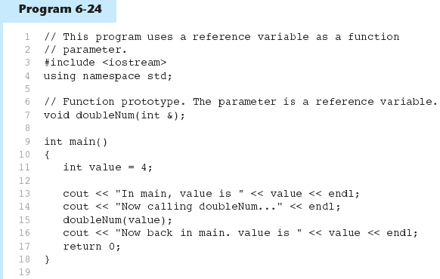
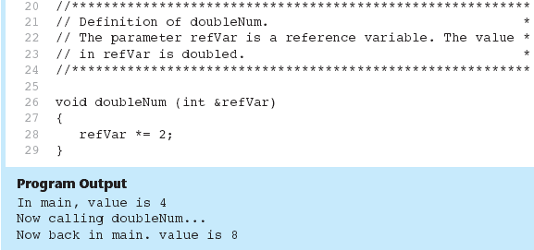
Example 1
The & here in the prototype indicates that the parameter is a reference variable.
Here we are passing value by reference.
The & also appears here in the function header.
PAGE 4

Slide 5
Reference Variable Notes
Each reference parameter must contain &.
Space between type and & is unimportant.
Must use & in both prototype and header.
Argument passed to reference parameter must be a variable – cannot be an expression or constant.
Use when appropriate – don’t use when an argument should not be changed by a function, or if a function needs to return only 1 value.
PAGE 5

Slide 6
Overloading Functions
Overloaded functions have the same name but different parameter lists.
Can be used to create functions that perform the same task but take different parameter types or different number of parameters.
Compiler will determine which version of function to call by argument and parameter lists to pass to the function.
PAGE 6

Slide 7
Function Overloading Examples
Using these overloaded functions,
void getDimensions(int); // 1
void getDimensions(int, int); // 2
void getDimensions(int, double); // 3
void getDimensions(double, double);// 4
the compiler will use them as follows:
int length, width;
double base, height;
getDimensions(length); // 1
getDimensions(length, width); // 2
getDimensions(length, height); // 3
getDimensions(height, base); // 4
PAGE 7

Slide 8
More info
[1] cplusplus.com: Variables and types.
https://www.cplusplus.com/doc/tutorial/variables/
[2] cplusplus.com: Overloads and templates
https://www.cplusplus.com/doc/tutorial/functions2/
[3] learncpp.com: 6.11 – Reference variables
https://www.learncpp.com/cpp-tutorial/611- references/comment-page-1/
[4] learncpp.com: 7.6 – Function overloading
https://www.learncpp.com/cpp-tutorial/76-function- overloading/
PAGE 8

